Slide 1
Webszolgáltatások
XML-alkalmazásokat képeznek le
programokra, objektumokra, adatbázisokra,
üzleti függvényekre.

Slide 2
|
| DBMS
| .NET hálózat <-> XML-üzenet <->| CORBA
| J2EE
| SAP
| interfész

Slide 3
Szabványok
XML
WSDL – Web Service Description Language
UDDI – Universal Description, Discovery and Integration
SOAP – Simple Object Access Protocol

Slide 4
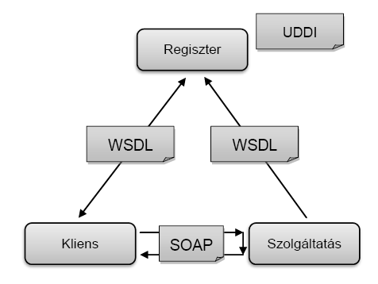
Webszolgáltatások architektúrája

Slide 5
WSDL
<definitions>
<message>
<portType>
<types>
<binding>
<service>
<documentation>
<import>

Slide 6
UDDI
UDDI adatmodell
- fehér oldalak
- sárga oldalak
- zöld oldalak
UDDI API
UDDI BR (Business Registry)

Slide 7
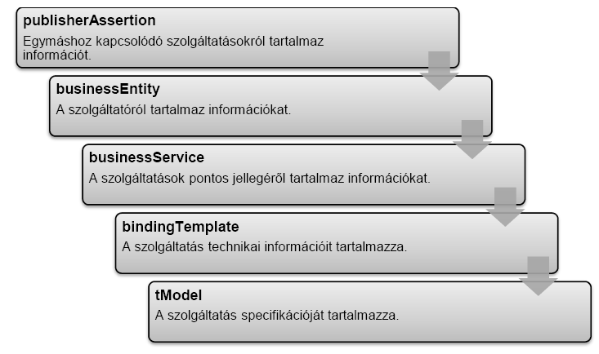
UDDI adatmodell

Slide 8
UDDI API műveletek
publikálás
törlés
keresés
lekérdezés
biztonság

Slide 9
SOAP üzenet részei
<envelope>
<header>
<body>
<fault>

Slide 10
SOA
Service Oriented Architecture

Slide 11
SOA összetevők
referencia architektúra
vállalati módszertan
irányítási modell
fejlesztési folyamat

Slide 12
A szolgáltatások
önálló entitások
zártak
lazán csatoltak
felhasználóik programok
implementációjuk nem ismert
leíróik egy-egy szerződést definiálnak
állapotmentesek vagy állapotőrzők

Slide 13
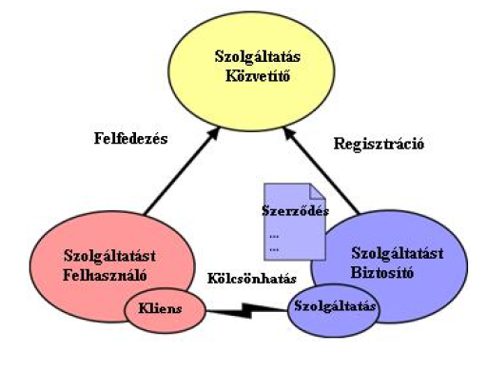

Slide 14
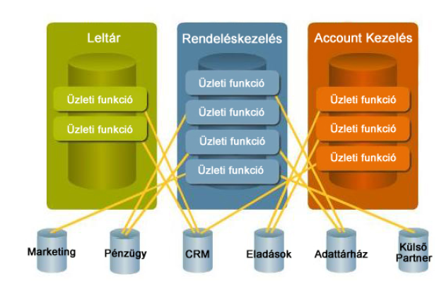

Slide 15
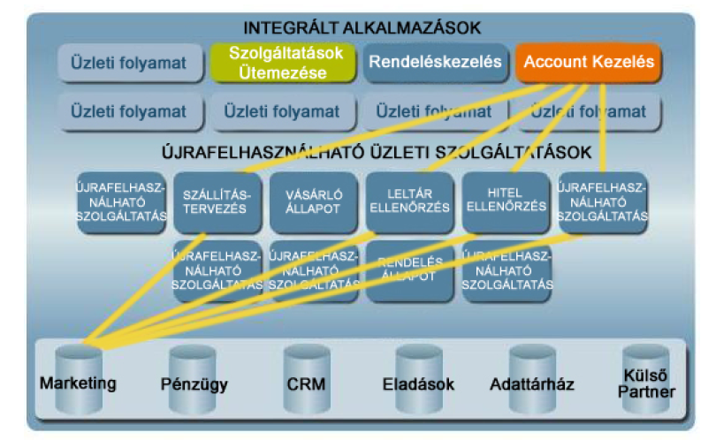

Slide 16
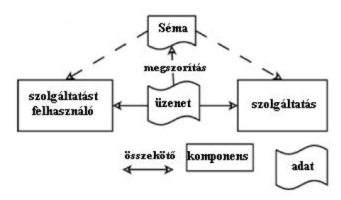

Slide 17
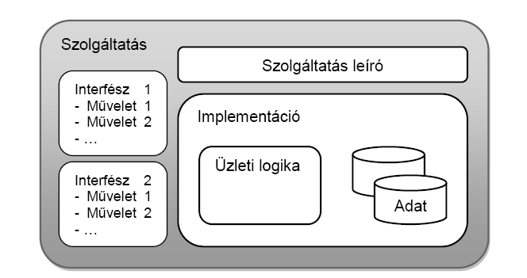

Slide 18
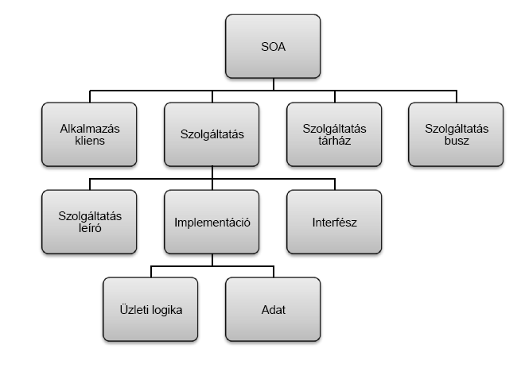

Slide 19
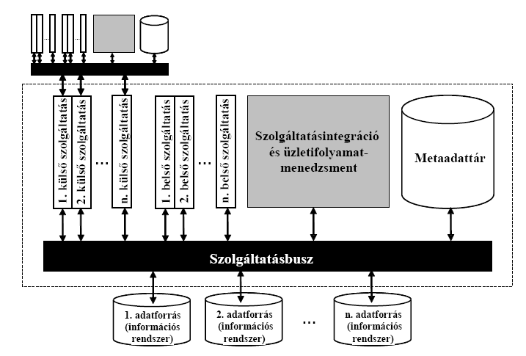

Slide 20
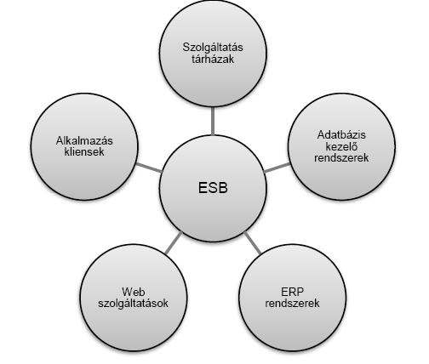
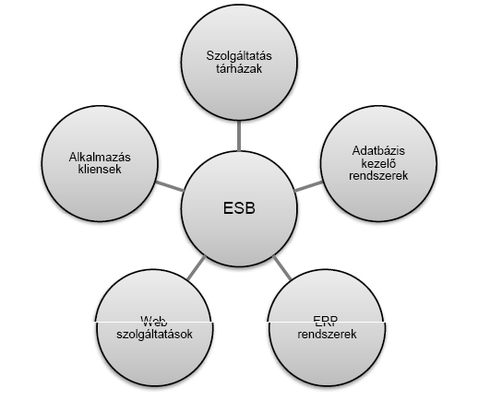
Enterprise Service Bus

Slide 21
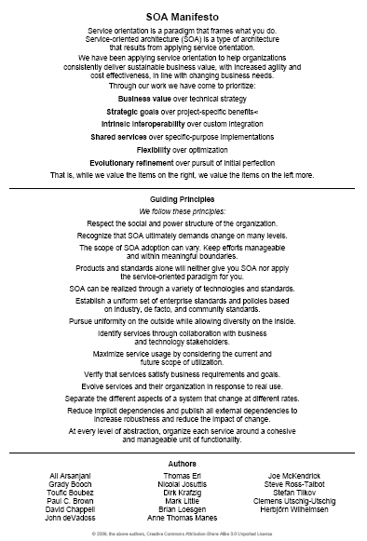

Slide 22
SOA Manifesto
Service orientation is a paradigm that frames what you
do.
Service-oriented architecture (SOA) is a type of
architecture that results from applying service orientation.
We have been applying service orientation to help
organizations consistently deliver sustainable business
value, with increased agility and cost effectiveness, in line
with changing business needs.

Slide 23
Through our work we have come to prioritize:
Business value over technical strategy
Strategic goals over project-specific benefits
Intrinsic interoperability over custom integration
Shared services over specific-purpose implementations
Flexibility over optimization
Evolutionary refinement over pursuit of initial perfection
That is, while we value the items on the right, we value
the items on the left more.

Slide 24
Guiding Principles
We follow these principles:
Respect the social and power structure of the organization.
Recognize that SOA ultimately demands change on many levels.
The scope of SOA adoption can vary. Keep efforts manageable
and within meaningful boundaries.
Products and standards alone will neither give you SOA nor apply
the service orientation paradigm for you.

Slide 25
SOA can be realized through a variety of technologies
and standards.
Establish a uniform set of enterprise standards and
policies based on industry, de facto, and community
standards.
Pursue uniformity on the outside while allowing
diversity on the inside.
Identify services through collaboration with business
and technology stakeholders.

Slide 26
Maximize service usage by considering the
current and future scope of utilization.
Verify that services satisfy business
requirements and goals.
Evolve services and their organization in
response to real use.
Separate the different aspects of a system that
change at different rates.

Slide 27
Reduce implicit dependencies and publish all
external dependencies to increase robustness
and reduce the impact of change.
At every level of abstraction, organize each
service around a cohesive and manageable unit
of functionality.

